Slide 1
Fall Design Presentation Tyler Brunelle

Slide 2
Overview
Title
Names
User Stories
Design Diagrams
Major Project Constraints
Review of Project Progress
Expected Accomplishments
Division of Work
Expected Demo at Expo

Slide 3

Title
Virtual AFWI
Purpose
Digital version of an existing board game, AFWI
Goals
Player v Player
Online
Tutorial
Improve game dev skills

Slide 4
Names
Team
Project Advisor
This is a solo project, just me
Tyler Brunelle
(614) 813-3392
bruneltw@mail.uc.edu
TBD
Name
Phone
Email

Slide 5
User Stories
Player: As a player of this wargame, I want to play AFWI digitally so that I can quickly hone my skills without needing the physical game components
Instructor: As an instructor of the game, I want the program to enforce the rules automatically, allowing players to focus on wargaming instead of rules disputes
New Player: As a new player, I want the game to have some sort of tutorial that teaches the basic mechanics of the game, so that I can quickly learn and start to play others

Slide 6
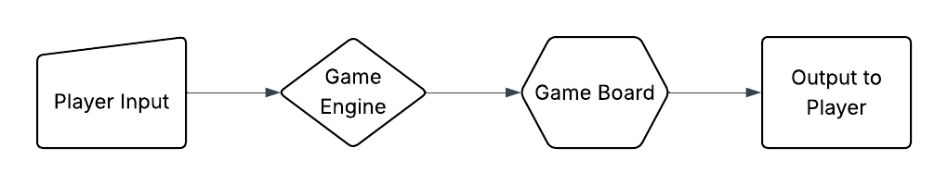
Design Diagrams
High Level Overview

Slide 7
Design Diagrams
High Level Overview

Slide 8
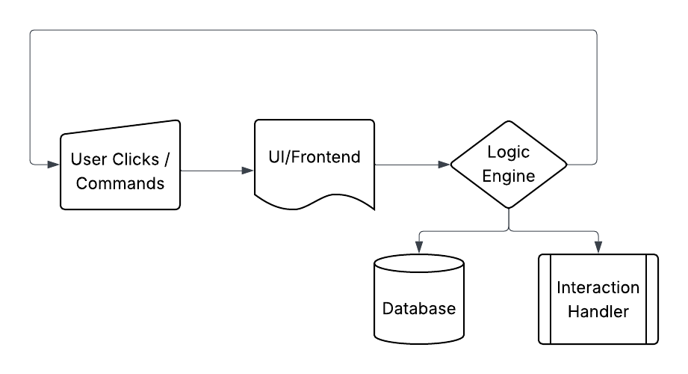
Design Diagrams
Interaction Breakdown

Slide 9
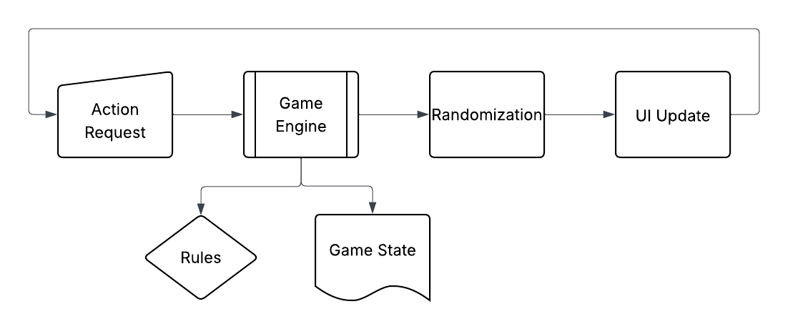
Design Diagrams
Turn Breakdown

Slide 10
Major Project Constraints
Technical Ability
Time
Legality

Slide 11
Current State & Expected Progress
Current State
Expected Progress by End of Semester
Research
Self-Teaching
Game Understanding
Technical Specifications
Detailed Game Flow Diagrams
UI Mockups
General Architecture

Slide 12
Division of Work
Solo Project
All Me!

Slide 13
Expected Demo
End State
Hands-on Gameplay
Tutorial

Slide 14
Summary
Title
Names
User Stories
Design Diagrams
Major Project Constraints
Review of Project Progress
Expected Accomplishments
Division of Work
Expected Demo at Expo

